Slide 1

CSC8633 Project: OULAD Investigation
Annie sames, Junzhe zhao, yimiao wang, Mayank baraksar, rosemary finnegan, avi gupta
Notes:
We are group 10, and this is our presentation which will outline the analysis that we have done to investigate the open university learning analytics dataset

Slide 2
PROBLEM STATEMENT
‘Help students gain autonomy to manage their own learning experience to achieve their maximum potential with the University technology services’
Notes:
The problem was presented to us by the Learning and Technology Development Service at Newcastle University and this was to help students gain autonomy to manage their own learning experience to achieve their maximum potential with the University technology services.

Slide 3
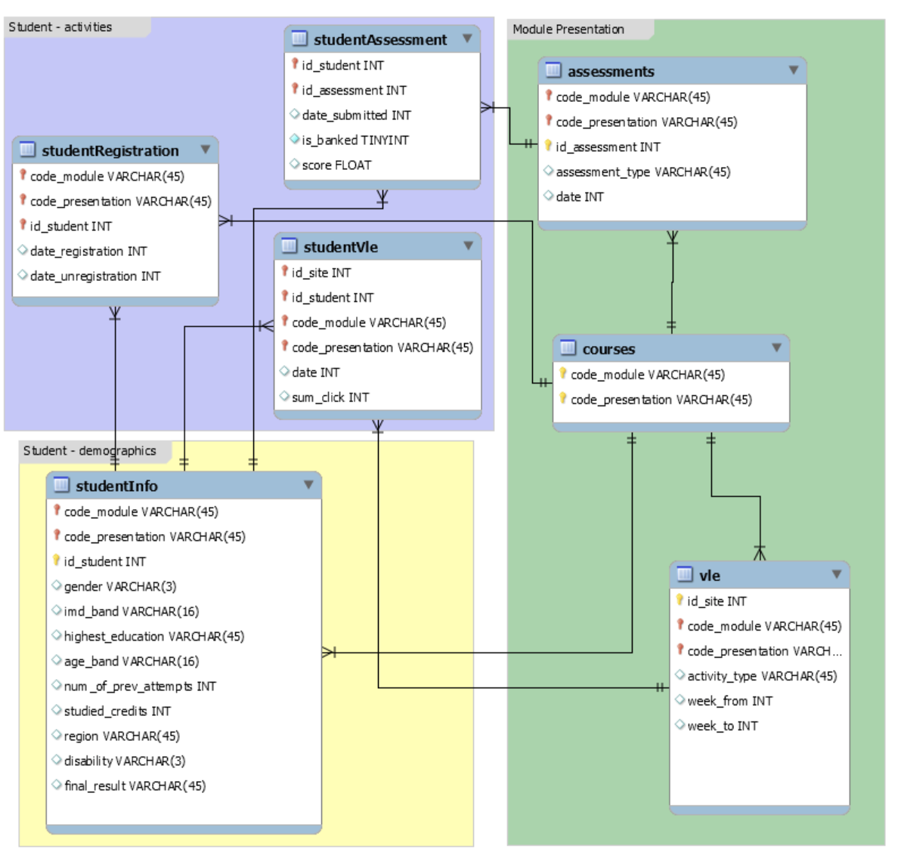
DATA
22 courses
Courses starting in February and October 2013 and 2014
Including:
Interaction with VLE
Final result
Length of module
Withdrawals
Notes:
The Open university learning analytics dataset was used to complete our investigation, and this contains information on 22 courses, each which had run in February and October of 2013 and 2014, and the interactions that the students had with the VLE on each of these. To successfully analyse this dataset, we broke it down into six separate parts, and then also created a predictive model to predict whether a student. Our aims included looking at the course interactions dependent on withdrawals, course length, late submission and average clicks

Slide 4
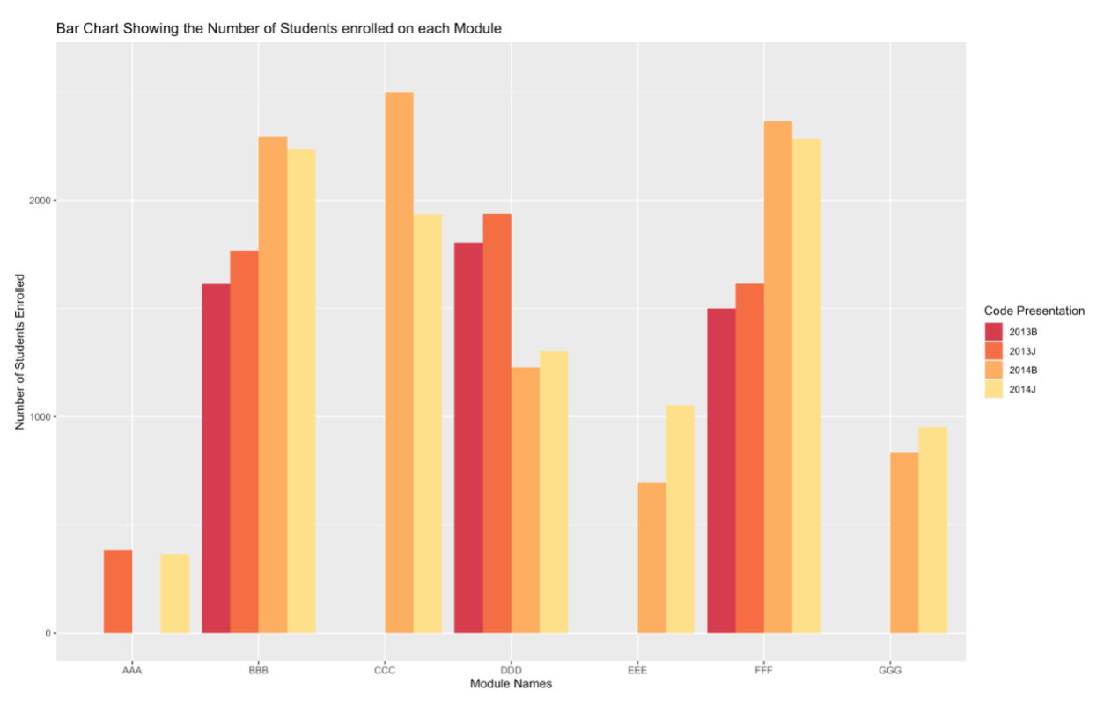
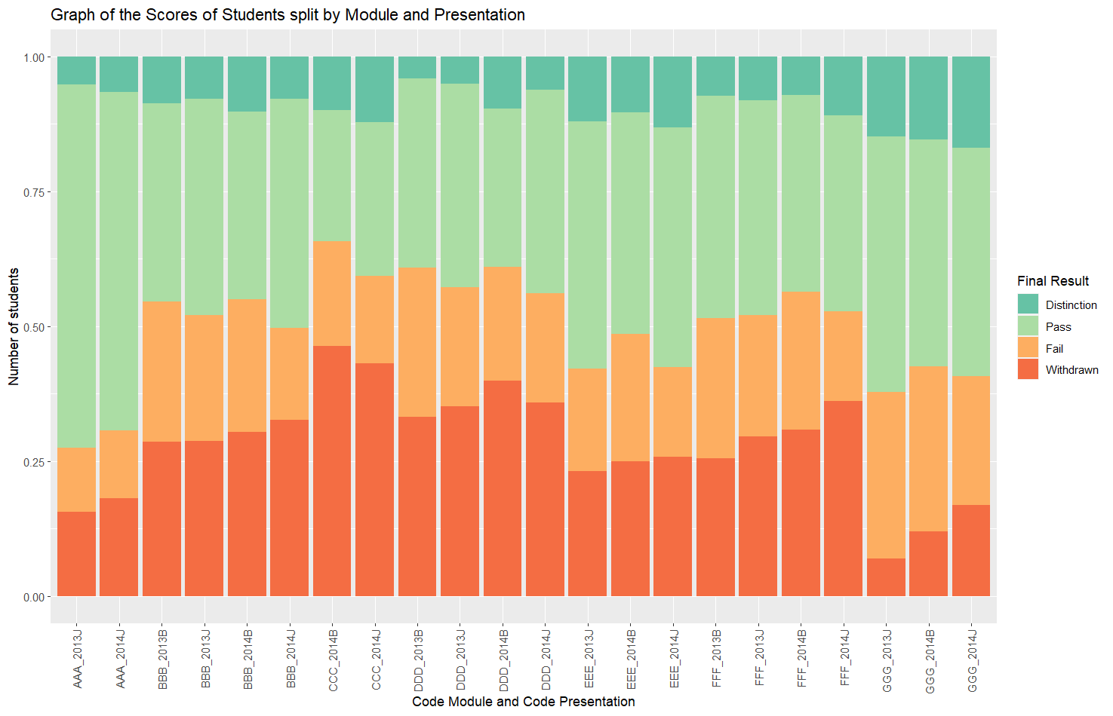
STUDENT ENROLMENT AND PERFORMANCE
Notes:
From figure the graph of student enrollments, it is evident that the module with the highest number of students enrolled onto it was CCC in febraury 2014. 2014B with 2498 students and the course with the least number of students enrolled onto it is AAA starting in October 2014. A t-test was conducted to compare these groups, which revealed a significant difference between the number of students enrolled in 2013 against 2014, with a p-value of 0.02519.
the course with the highest percentage of students passing or achieving a distinction was AAA starting in October 2013, with nearly 75% of the enrolled students passing or getting a distinction. This is in contrast with the results from module CCC, starting in February 2014, where only around 30% of people achieved a pass or distinction.
There may be several reasons for these differences, including course difficulty, assessment type, or even the people enrolled on the course, however, something which can be analysed is the activity types for each of the courses.

Slide 5
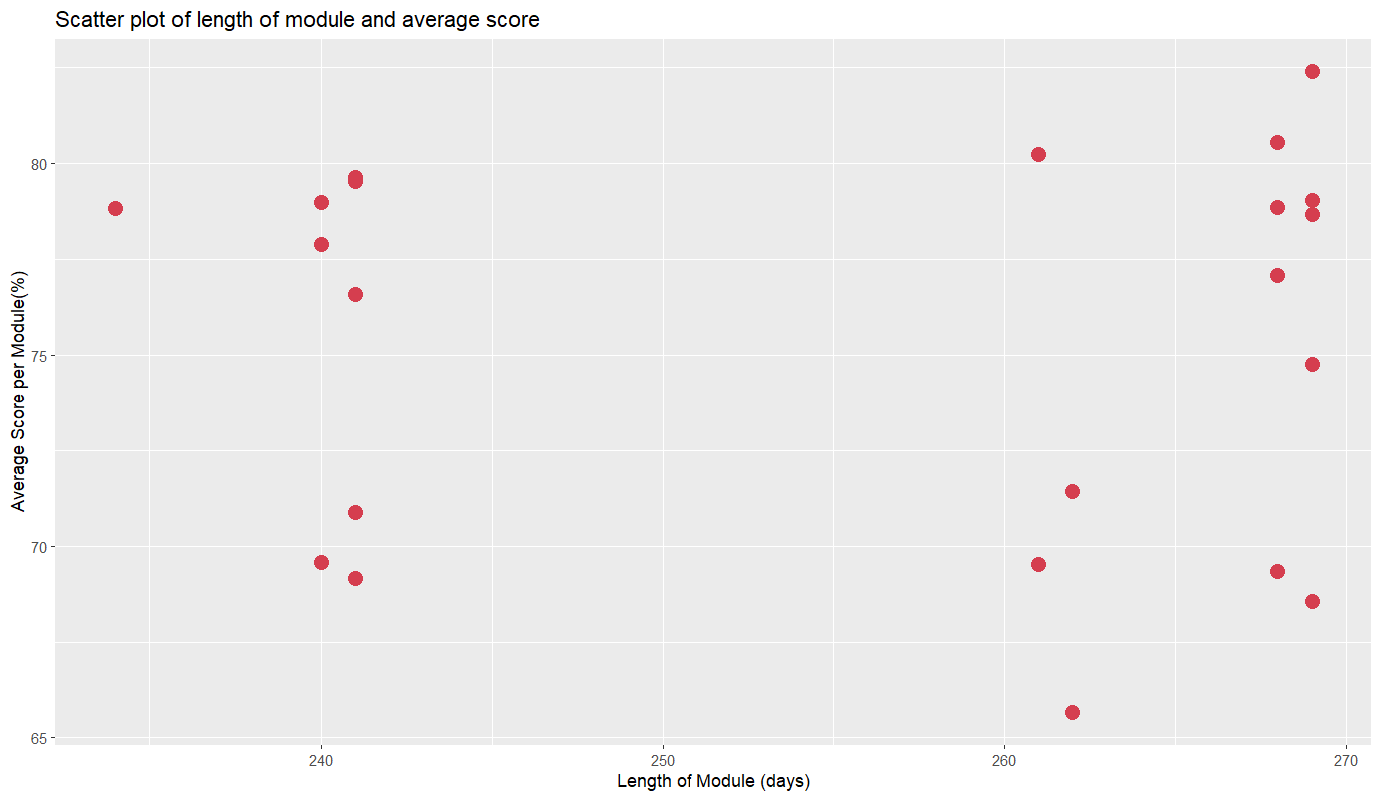
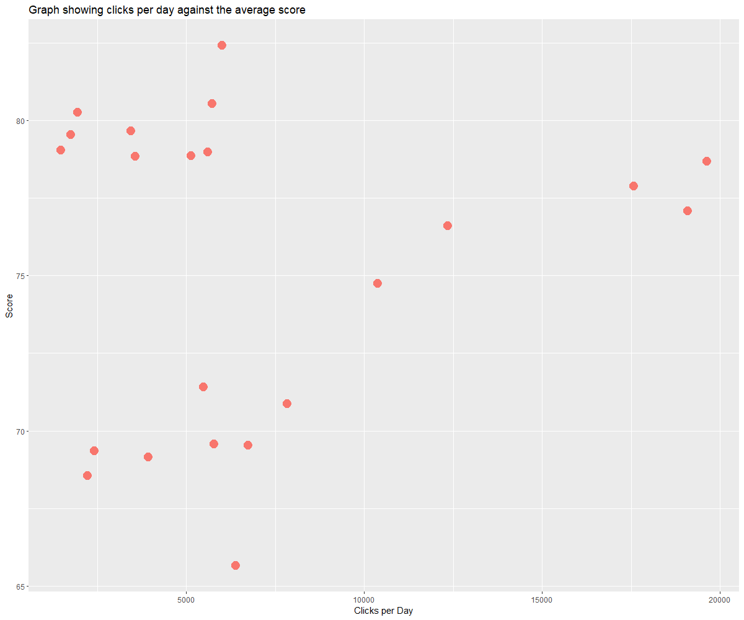
EFFECT OF MODULE LENGTHS
Length of Module vs Average Score
Clicks per Day vs Score
Notes:
From this, it is evident that there is no obvious relationship between the length of the module and the final results of the students. A Pearson’s correlation test was carried out and this revealed a non-significant relationship between module length and average score. The courses below 250 were compared with the courses above 250 days, and a t test revealed no significnat difference between the performance of students in these courses. Even though there is no significant difference, these observations may be beneficial to the Open University as they demonstrate that there is no real benefit to increasing the length of the module as it does not improve the students’ final results. to measure the interaction throughout the course, a A Pearson's correlation test was used to assess the significance of the relationship between the clicks per day and the average score revealed a significant correlation of 0.4339079, with a p-value of 0.04363. This means that as the clicks per day increase, the average score also increases, so despite courses being longer having no effect on score, if more interactions are made within that time frame, the overall score is likely to be higher.

Slide 6
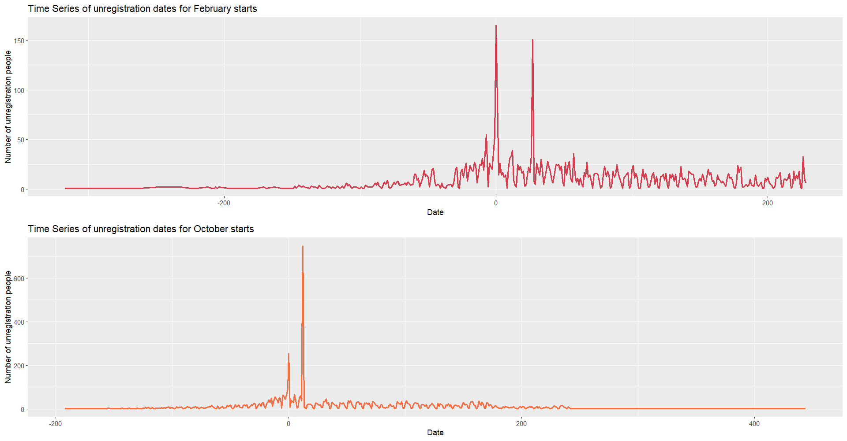
STUDENT WITHDRAWALS
Withdrawal dates show a similar pattern for February and October start dates
Slightly later for February starts
Most but not all withdrawals happen at or near start of module
Refund dates could be one reason, or modules not meeting students' expectations
OU can use this data to take targeted interventions

Slide 7
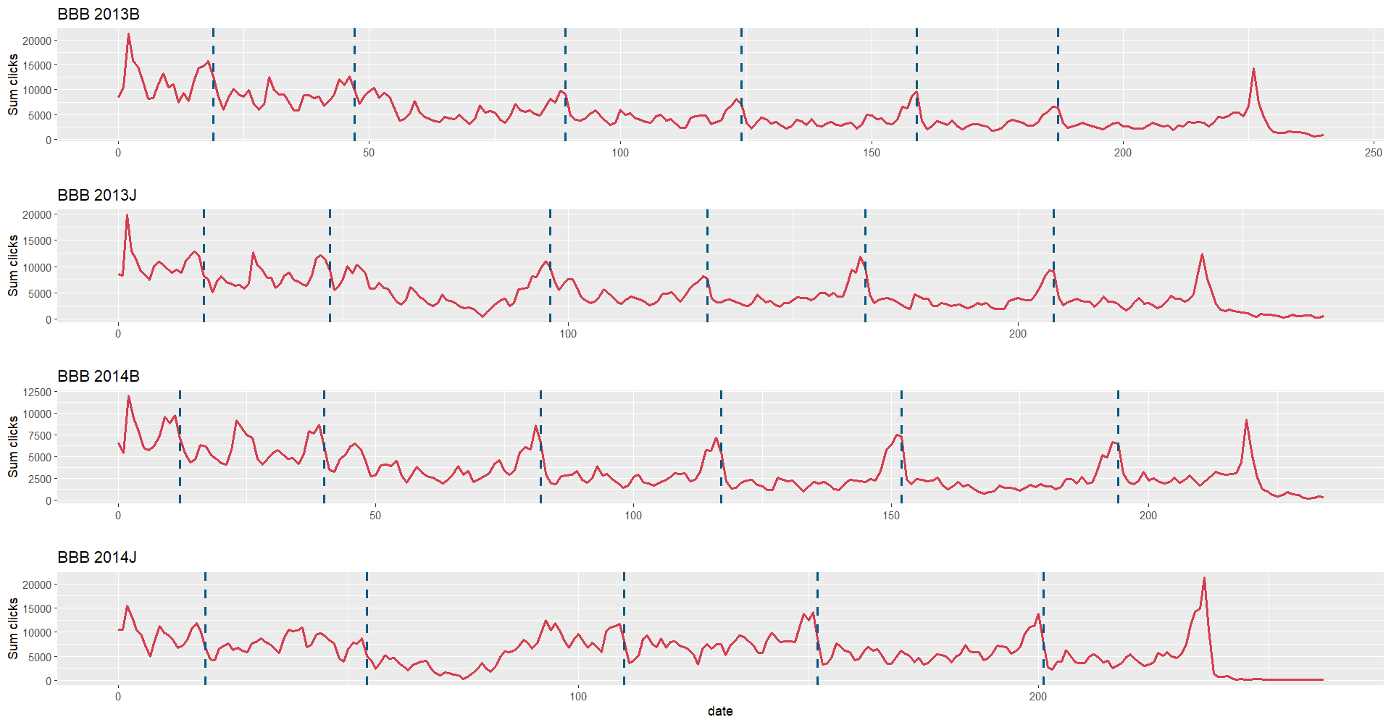
Student Daily Activity (Sum of Clicks)
Time Series of Sum Clicks in Module B （TMA Assessment)
The number of hits increases significantly as the exam approaches.
The code for the demo module with the maximum number of clicks is BBB2014J
Max(Sum click=21336,Date=236)
Min(Sum click=58,Date=259).

Slide 8
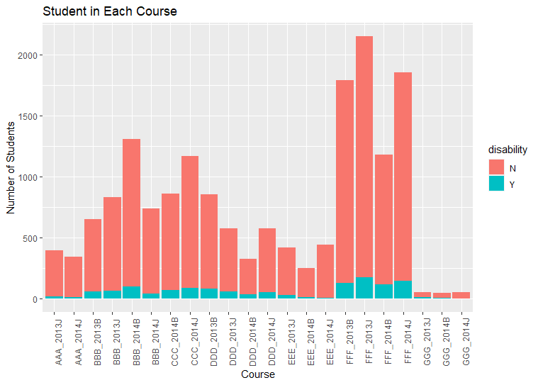
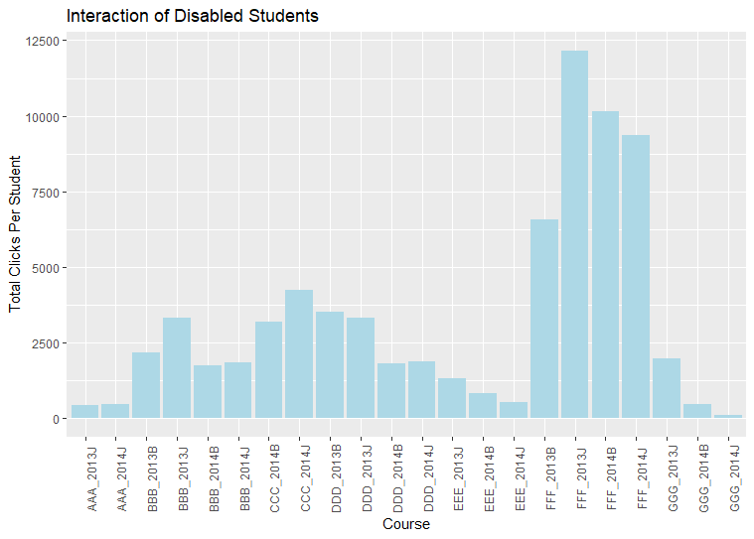
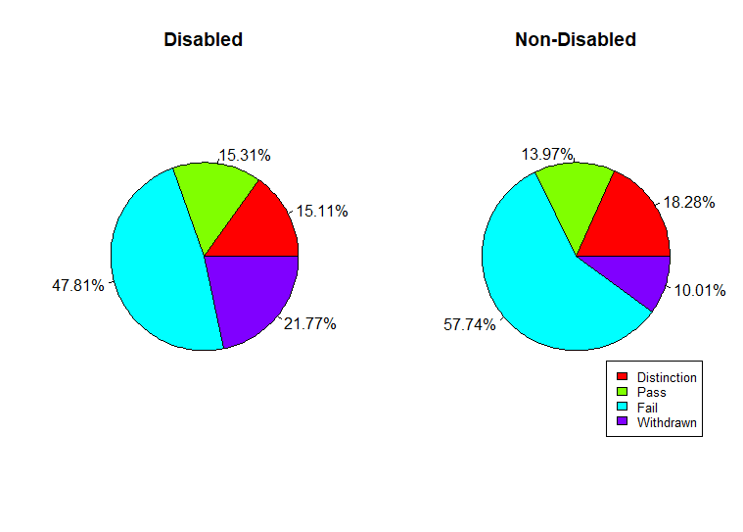

Student Disability

Slide 9
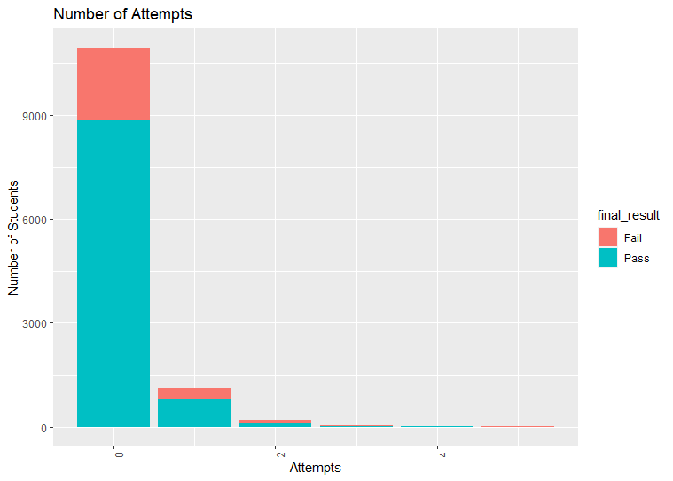
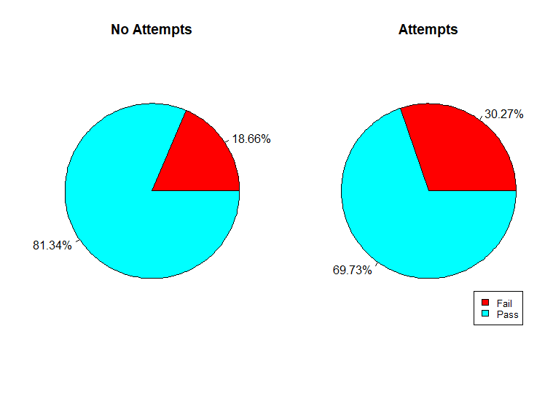
Number of Attempts

Slide 10
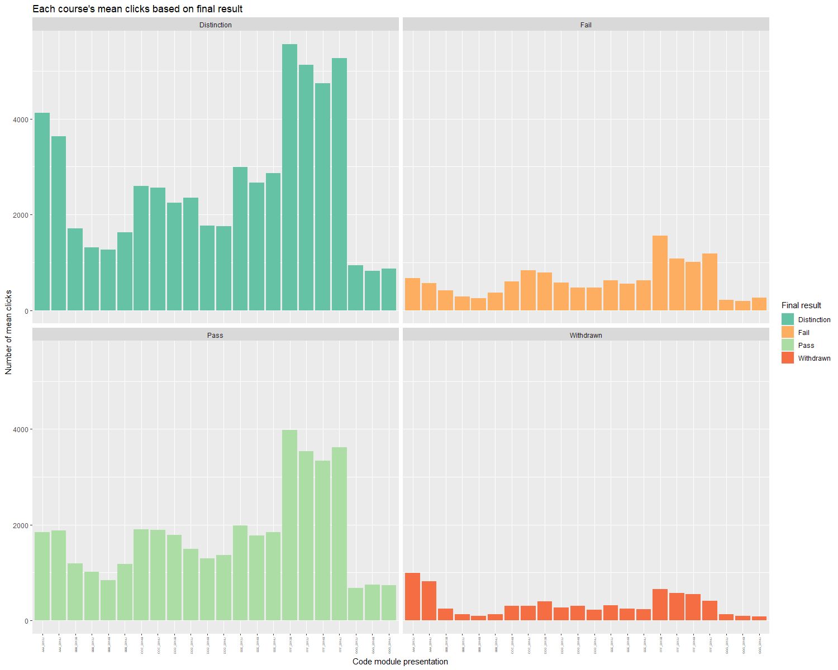
Relationship between Final Result and Sum clicks
For all modules, there was a very significant difference between the mean of the number of sum of clicks for students that withdrew and those that did not withdraw. All p-values were below 0.05.

Slide 11
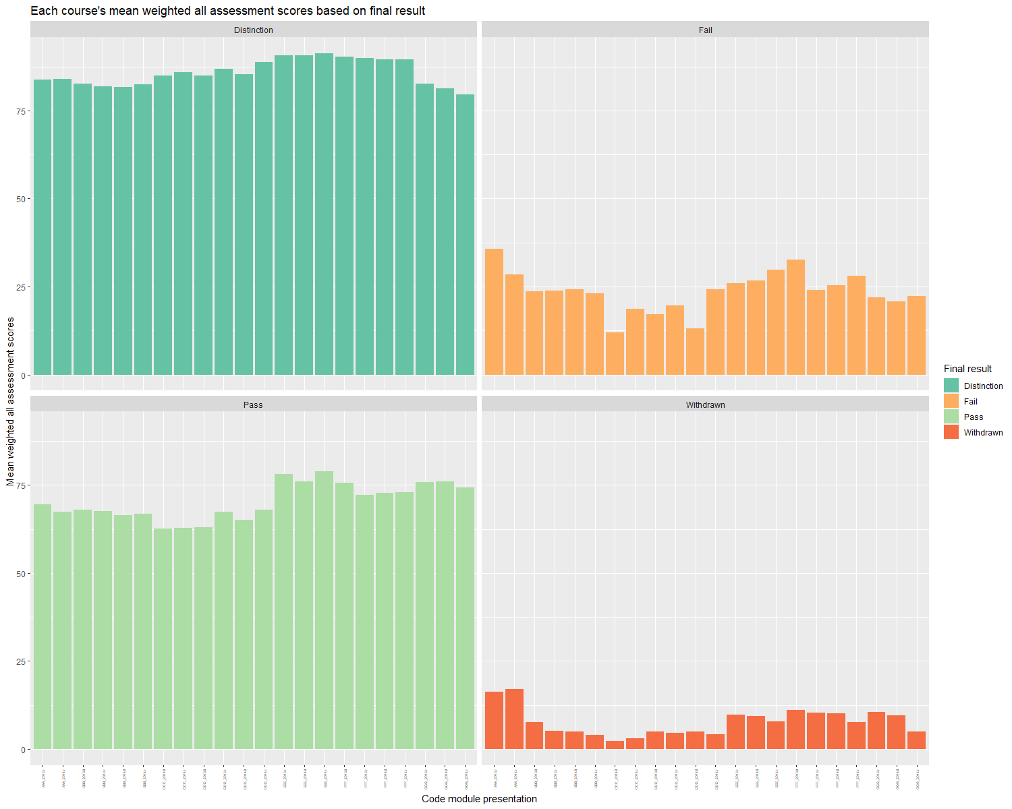
Relationship between Final Result and Final Assessment
Q-Q Plot , Shapiro test tested for normality
Variance difference test
T-test hypothesis testing correlation
P-value < 0.05
A significant relationship between Final Result and Final Assessment.

Slide 12
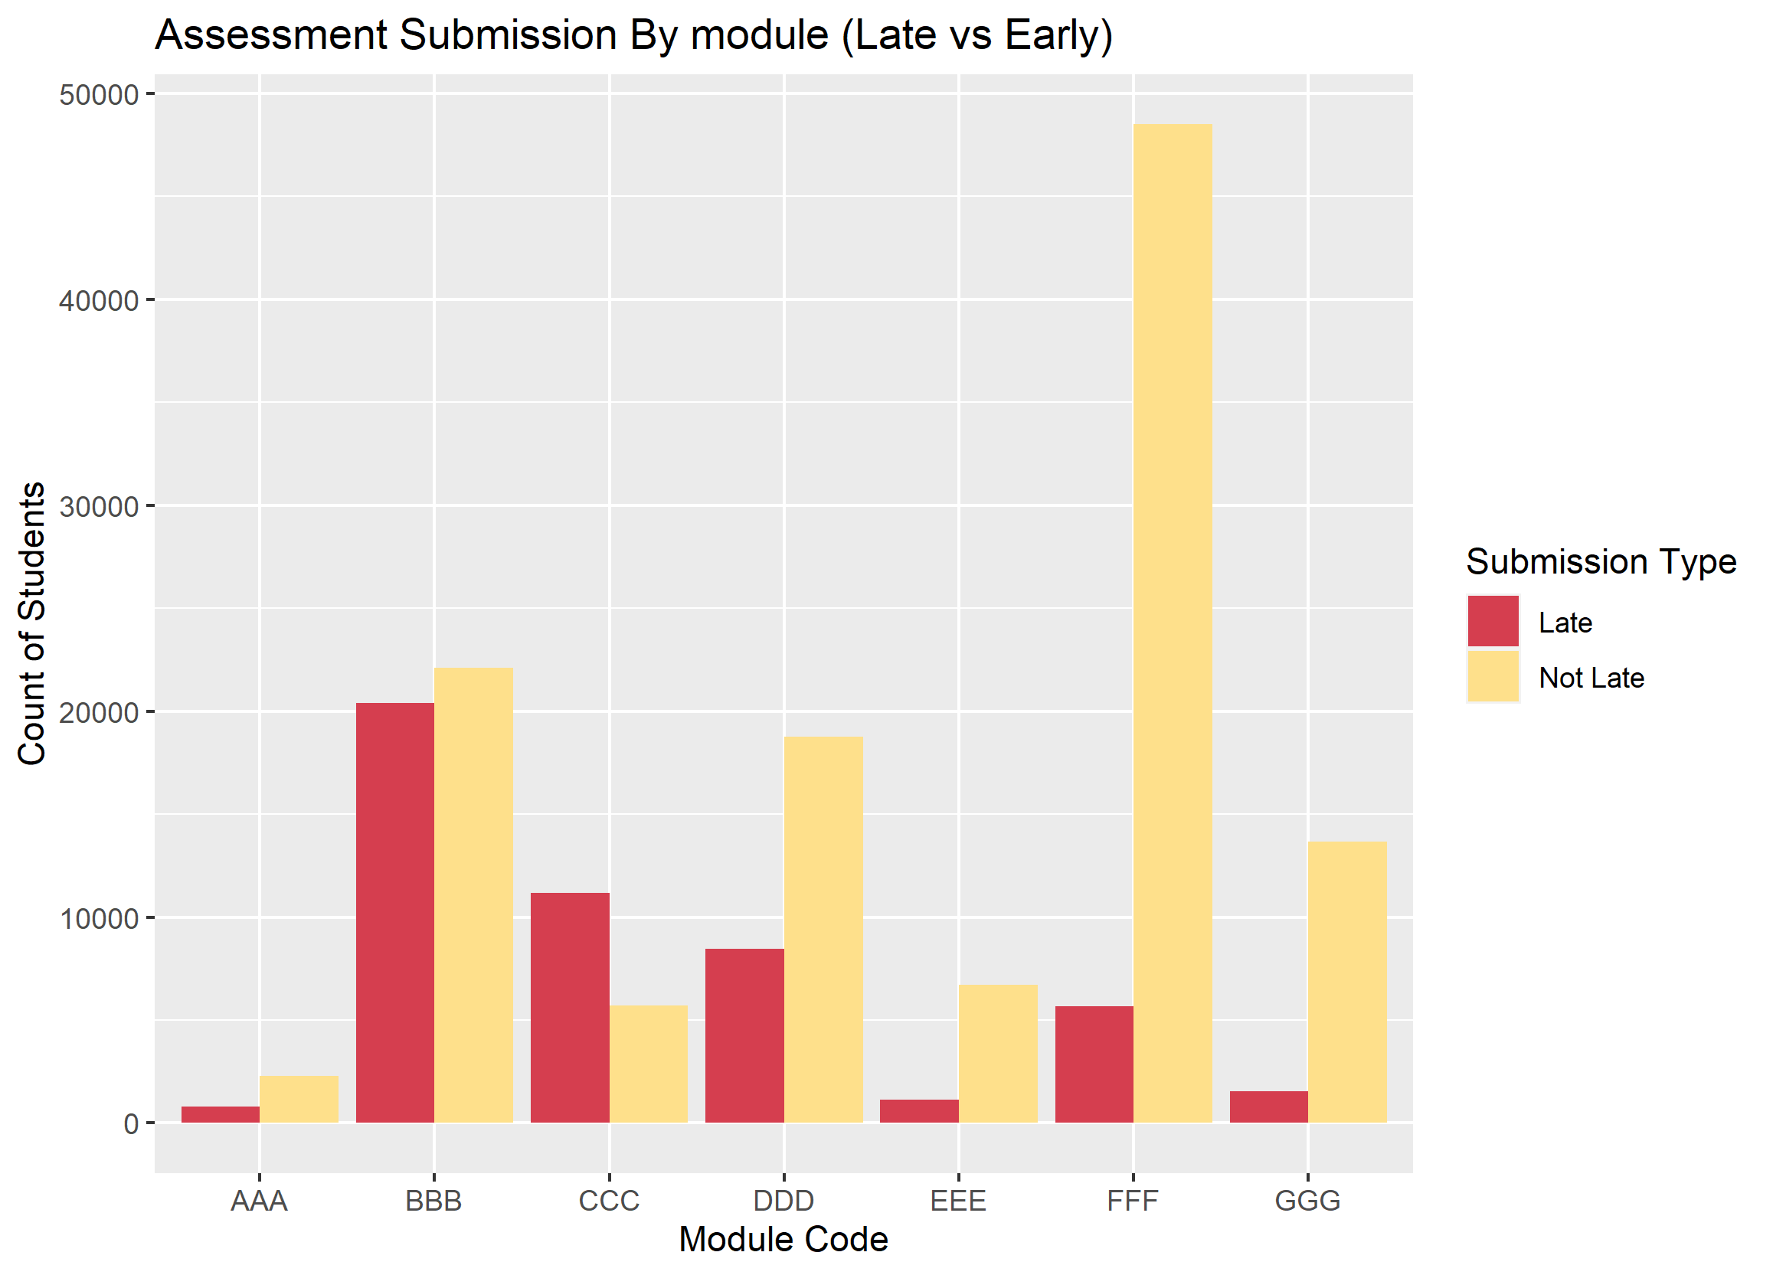
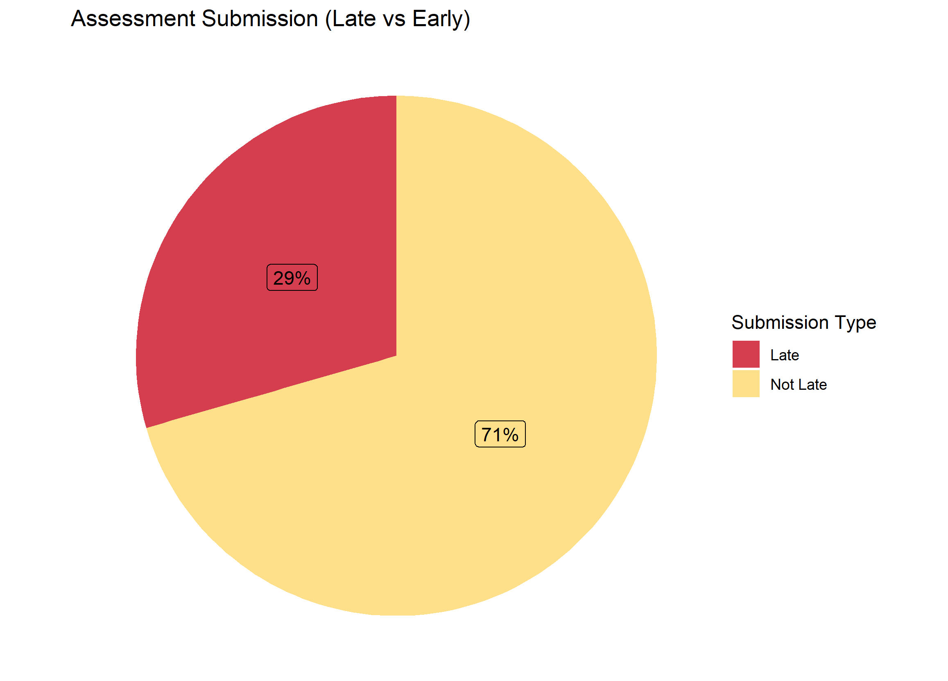
Relationship between date of submission and assessment score

Slide 13
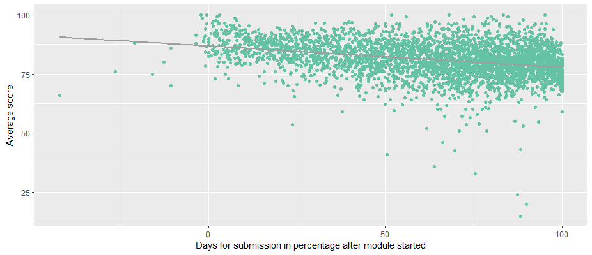
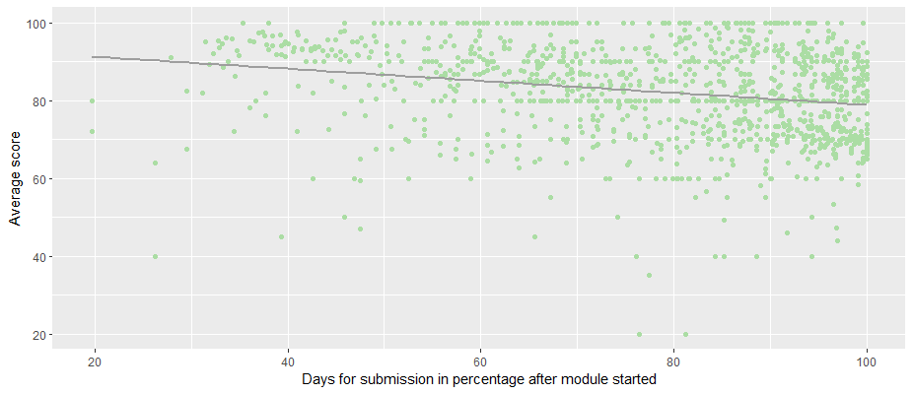
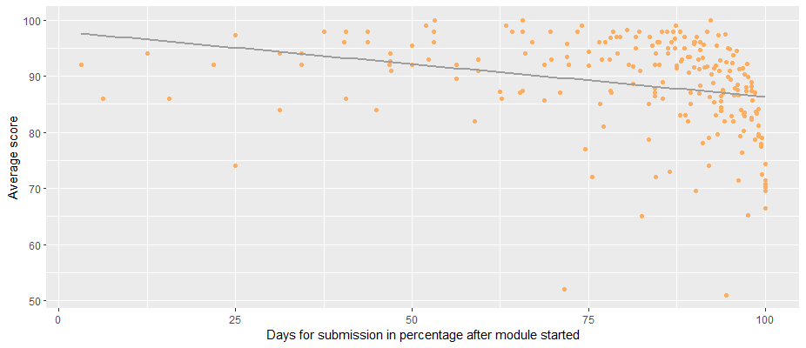
Effects of Late submissions
FFF Module
GGG Module
CCC Module

Slide 14

Predicted Model
Use 3 indicators to predict final result
Use 10-fold cross-vlidation
Use logistic regression, LDA, QDA, SVM to fit model
Use trained model to predict test datasets
Scale three variables
1. Weighted assessment scores
2. Sum clicks
3. Number of late submissions
Model Name | Test error(%) | AUC
Logistic regression | 8.018% | 96.735%
LDA | 7.950% | 91.142%
QDA | 8.831% | 90.659%
SVM | 8.111% | 90.896%
Logistic regression(L1) | 7.931% | 96.734%
Logistic regression(L2) | 7.875% | 96.733%
Final result: passing (pass or distinction), failing (fail or withdrawn)

Slide 15
